Slide 1
Peabody investor update
2024
Investor update - April 2024

Slide 2
Homes
107,449
Peabody at a glance
Residents
220,000
Our purpose: We want to help people flourish. We do this by providing great homes and housing services, making a positive impact in communities and creating an inspiring, inclusive place to work.
Our priorities:
All about people.
Getting the basics right.
Creating a sustainable Peabody.
Operating surplus
£257m
Total Group assets
£12.7bn
Credit ratings (M / S&P)
A3 / A-
Regulatory grading
G1 / V2

Slide 3
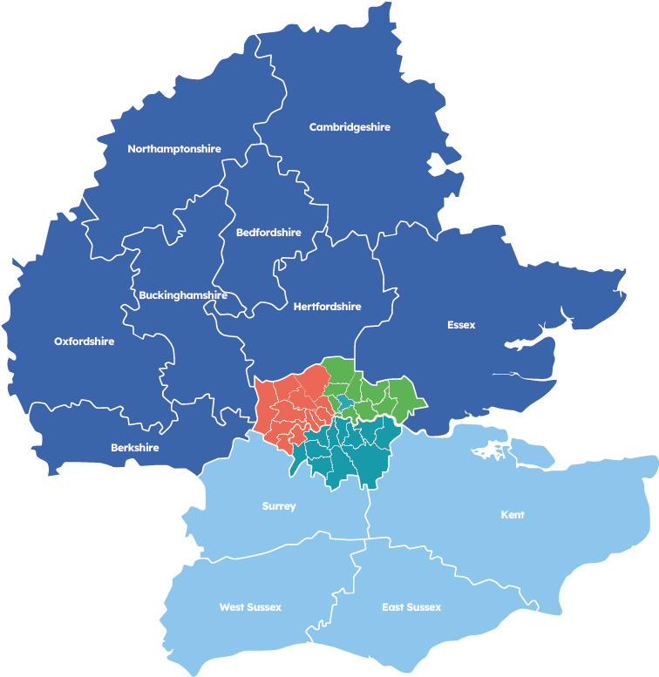
Local Peabody
North Counties
20,388
North and West London
26,507
South Counties
13,376
South London
23,468
North East London
23,710
Total
107,449

Slide 4
External environment
Consumer regulation and increased scrutiny on overall quality of resident services.
Ongoing engagement and dialogue with the regulator, ombudsman and government.
Political uncertainty and long-term planning around rent settlements.
Sustainability and the journey to net zero.
Pressure to build much-needed new social homes.
Borrowing costs continue to remain elevated despite falling inflation.

Slide 5
Leadership team
Update

Slide 6
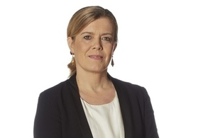
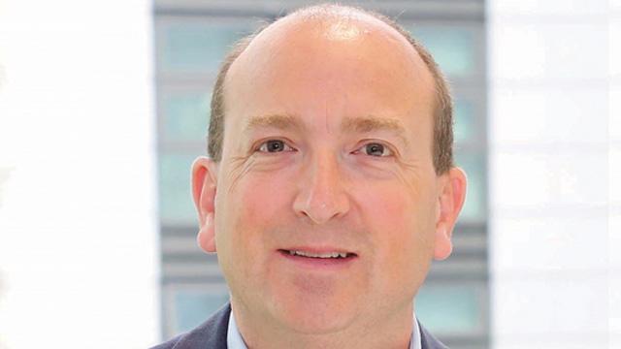
Leadership changes
Caroline Corby - Chair of Peabody Group
Caroline took up the role of Chair on 1 April, with Interim Chair David Hardy becoming Vice-Chair.
She has extensive experience in the social housing sector as a former Chair of One Housing and Vice Chair of Riverside Group. She continues to chair the Professional Standards Authority for Health and Social Care and the Parole Board for England and Wales.
Elly Hoult - Chief Operating Officer and Deputy Chief Executive Officer
Elly adds the role of Deputy Chief Executive to her existing Chief Operating Officer position, broadening her remit to include executive responsibility for Town & Country Housing.
Phil Day - new Chief Financial Officer
Phil joins Peabody with 20 years of senior experience in social housing, eight of which were at Peabody. Most recently he spent seven years as Group Finance Director at the Guinness Partnership.
Phil will re-join Peabody on 2 September. Current CFO Eamonn Hughes will remain in post until the end of June.
To find out more about our leadership, see Peabody corporate structure – leadership team - Peabody (peabodygroup.org.uk)

Slide 7
Our financial
Performance

Slide 8
Half-year results to September 2023
Key themes and highlights
Operating surplus and margin steady and consistent with prior year.
£184m invested in existing homes (includes £43m on building safety.)
Development continues to be managed carefully, with the number of unsold homes substantially lower than in previous years.
£268m invested in new homes, 654 completions and 470 starts on site.
42,000 unencumbered properties with £4bn security value.
Investment in existing homes*
£184m
New homes completed
654
Operating margin
27%
Available facilities
£1.3bn
* Includes £84m routine repairs and maintenance. Figures in the Half Yearly Update for September 2023 are based on unaudited management accounts, which are subject to review and further adjustments

Slide 9
Half-year results 2023-24
 | Six months to Sep-23 | Six months to Sep-22
Homes in management | 108,289 | 104,540
Homes completed in the period | 654 | 1,004
Investment in existing homes | 100 | 65
Turnover (£m) | 489 | 515
Operating surplus | 131 | 137
Operating margin | 27% | 27%
Surplus for the period (£m) | 41 | 79
Drawn debt (£m) | 4,680 | 4,445
Available facilities (£m) | 1,313 | 1,722
Accessible cash (£m) | 71 | 113

Slide 10
Statement of comprehensive income
£million | Six months to Sep-23 | Six months to Sep-22
Turnover – from core operations | 414 | 383
Turnover – from sales | 75 | 132
Total turnover | 489 | 515
Operating costs | 332 | 299
Cost of sales | 62 | 121
Surplus staircasing/disposal of fixed assets | 36 | 42
Operating surplus | 131 | 137
Net interest costs – incl loan break costs | 90 | 72
JV surplus | - | 14
Surplus for the period | 41 | 79
Operating margin | 27% | 27%
Sales margin | 17% | 8%

Slide 11
Financial monitoring and performance
Maintain A credit rating with S&P and Moody’s.
V2 is an acceptable viability rating.
Investment in homes but Peabody Trust interest cover has substantial headroom to covenant.
Limits to overall level of borrowing as well as gearing < 50%.
Limitations on level of sales as measured without social housing lettings.
Group EBITDA MRI (RSH Metric) remains key focus for improvement.

Slide 12
Impact of Catalyst merger – increased scale, gearing stable
Data from the 2022/23 Annual Report and Accounts
Peabody investor update
April 2024

Slide 13
Our operating
Performance

Slide 14
Consumer regulation
Fully supportive of, and committed to introducing, the new consumer standards.
The changes are consistent with our existing priority of ‘Getting the basics right’.
Focus from ombudsman and regulators on quality of service aligns with our own priorities of investing in existing homes and services for residents.
Listening and ensuring we identify every opportunity to make things right, learn lessons and improve our services.

Slide 15
Resident services
Low rents: Our rents in 2022-23 were £621m lower than market levels at an average of £127 per week.
Supporting residents and communities in 2022-23:
- Nearly 900 people helped into work and apprenticeships. - 3,526 people helped to improve their skills and 689 to achieve qualifications. - Almost 17,500 people benefit from care and support services. - 546 people saved money on their energy bills through the energy advice service.
Empowering residents: Listening events and our resident-led strategic panel help us find out what really matters to residents and improve our services accordingly.
Getting the basics right: My Peabody makes it easier for residents to access our services and information about their home. Publishing information and outcomes relating to complaints and repairs helps us reduce wait times and improve the service. Peabody 360, Power BI and other advances represent transformation of our services.

Slide 16
Sustainability
Sustainability Action Plan: What we're doing to be net zero in our day-to-day business by 2030 and in all rented homes by 2050.
RITTERWALD’s Certified Sustainable Housing Label: Recently reaccredited for a third time.
Decarbonisation Roadmap: How we plan to cut our greenhouse gas emissions. In 2022-23, direct emissions from our operations (scope 1) fell 8.2%. Overall emissions rose 13% due to the inclusion of Town & Country Housing and increased investment in homes.
Energy efficiency: 78% of our homes are rated EPC C or above. Aiming for 82% by 2026. All new homes are built to at least EPC B.
Social value: Building green, healthy and sustainable places where residents and nature can thrive together. Helping residents reduce their bills and become more environmentally aware.

Slide 17
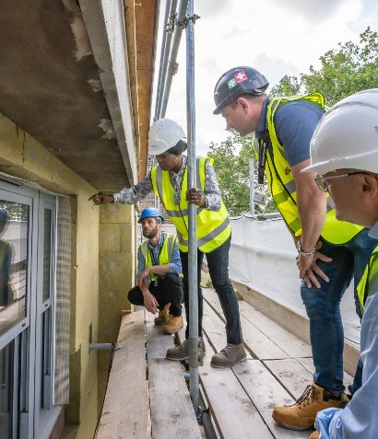
Building safety
We spent £266m on fire and building safety over five years. This includes £66m in year to 31 March 2023 and a further £43m in the six months to September 2023.
In total we have 7,102 buildings/cores.
1,174 are the focus of fire and building safety legislation. Of these, 591 are low risk and 289 certified safe for occupation.
42 buildings are currently being remediated, with 112 identified as requiring work over next four years.

Slide 18
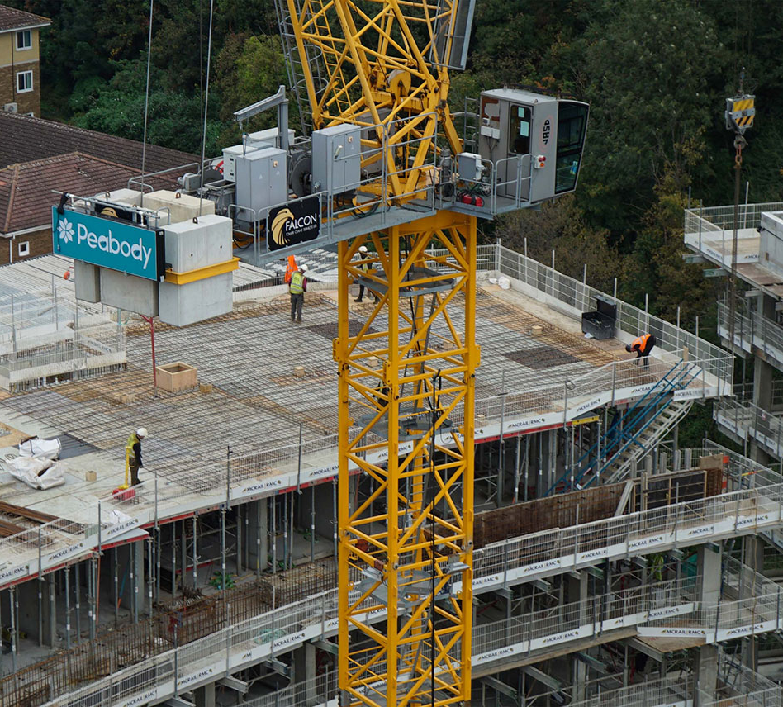
New homes
Development programme has been aligned to reflect current conditions.
£268m invested in first six months – 654 new homes completed, 470 starts on site.
Fewer than 100 available properties unsold by 30 September 2023.
2,399 homes completed in the year to March 2023, including 1,013 at social/affordable rents and 861 shared ownership.
Schemes include St John’s Hill Phase 3, Holloway Prison, Dagenham Green and in Thamesmead.

Slide 19
Contractor insolvency risk
Requires careful management.
Assess the finances of all counterparties regularly, monitoring exposure and the likelihood of insolvency risk. Mitigate against performance bonds, parent company guarantees and retention levels.
Our own construction inspectors provide an early warning system for any potential problems and create response plans.
Ensure the non-executive committee is aware of counterparty risk, including contractor insolvency.

Slide 20
Our new EMTN
Programme

Slide 21
In February this year we established our first Euro Medium Term Note (EMTN) Programme.
The £1bn programme will enable us to access capital markets more quickly and easily.
The proceeds will help us maintain and improve residents’ homes and develop new affordable homes and sustainable places.
In 2022-23 we spent £356m on residents' homes and £567m on new homes.
The EMTN Programme follows our £350m debut sustainability bond issued in 2022 via our Sustainable Finance Framework (SFF) and Impact Report (June 2023)
Peabody’s existing ratings of A3/A- (M/S&P) have been extended to the new programme.
The programme will allow for both secured and unsecured issuance.
3rd Ritterwald accreditation secured and we'll update our SFF prior to any issuance.

Slide 22
Thank you for
listening

Slide 23
Disclaimer
The information contained in this investor presentation including the presentation slides and any related speeches made or to be made by the management of the Peabody Group (Peabody being Peabody Trust and its subsidiaries), any questions and any answers thereto or any related verbal or written communications in respect thereof (the Presentation) has been prepared to assist interested parties in making their own evaluation of Peabody. This presentation is believed to be in all material respects accurate, although it has not been independently verified and does not purport to be all-inclusive. This Presentation and its contents are strictly confidential, are intended for use by the recipient for information purposes only and may not be reproduced in any form or further distributed to any other person or published, in whole or in part, for any purpose. Failure to comply with this restriction may constitute a violation of applicable securities laws. By reading this Presentation, you agree to be bound by the following limitations.
Neither Peabody (nor any constituent part thereof) nor its or their representative directors, officers, managers, agents, employees or advisers or their respective affiliates, makes any representations or warranty (express or implied) or accepts any responsibility as to or in relation to the accuracy or completeness of the information in this Presentation (and no one is authorised to do so on behalf of any of them) and (save in the case of fraud) any liability in respect of such information or any inaccuracy therein or omission therefrom is hereby expressly disclaimed, in particular, if for reasons of commercial confidentiality information on certain matters that might be of relevance to a prospective purchaser has not been included in this Presentation.
No representation or warranty is given as to the achievement or reasonableness of any projections, estimates, prospects or returns contained in this Presentation or any other information. Neither Peabody nor any other person connected to Peabody shall be liable (whether in negligence or otherwise) for any direct, indirect or consequential loss or damage suffered by any person as a result of relying on any statement in or omission from this Presentation or any other information and any such liability is expressly disclaimed. This Presentation may include certain statements, estimates and projections prepared and provided by Peabody’s management with respect to the anticipated future performance
of Peabody. Such statements, estimates and projections reflect various assumptions by Peabody’s management concerning anticipated results and have been included solely for illustrative purposes. No representations are made as to the accuracy of such statements, estimates or projections or with respect to any other materials herein. Actual results may vary from the projected results contained herein.
Any Notes issued by Peabody Group have not been and will not be registered under the U.S. Securities Act of 1933, as amended (the Securities Act), or the laws of any state or other jurisdiction of the United States, and may not be offered or sold within the United States, or for the account or benefit of, U.S. Persons (as such terms are defined in Regulation S under the Securities Act), absent registration or an exemption from, or in a transaction not subject to, the registration requirements of the Securities Act and applicable state laws. This Presentation is made to and is directed only at persons who are (a) “investment professionals” as defined under Article 19 of the Financial Services and Markets Act 2000 (Financial Promotion) Order 2005, as amended (the Order) or (b) high net worth entities falling within article 49(2)(a) to (d) of the Order (all such persons together being referred to as relevant persons). Any person who is not a relevant person should not act or rely on this Presentation or any of its contents. Any investment or investment activity to which this Presentation relates is available only to and will only be engaged in with such relevant persons.
Peabody investor update
April 2024

