Slide 1
Peabody Investor update
November 2024

Slide 2
What we’ll be covering
New Peabody
2023-24 update
Our operating environment
Our financial performance
Sustainable finance
Our homes
Creating a sustainable Peabody
Q&A
Ian McDermott
Chief Executive (Host)

Slide 3
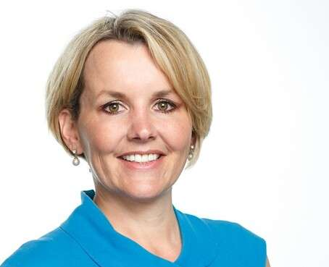
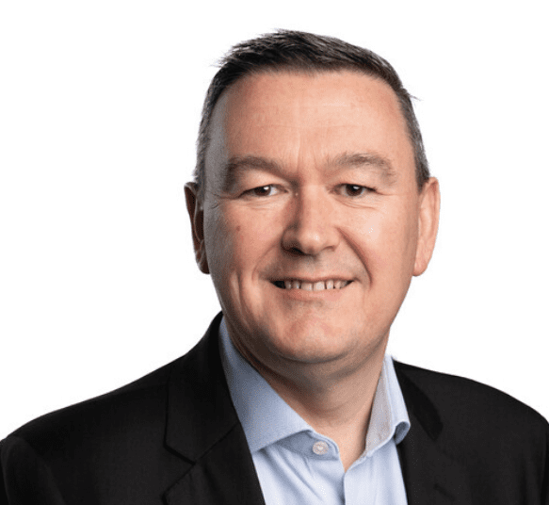
Peabody executive team
Ian McDermott
Chief Executive Officer
Phil Day
Chief Financial Officer
Stephen Burns
Executive Director, Care, Supported Housing and Inclusion
Sarah Cameron
General Counsel & Company Secretary
Elly Hoult
Deputy Chief Executive & Chief Operating Officer
Peter Evans
Executive Director, Property Services & Assets
Philip Jenkins
Executive Director, Development
John Lewis
Executive Director, Sustainable Places
David Lavarack
Executive Director, Group Support Services

Slide 4
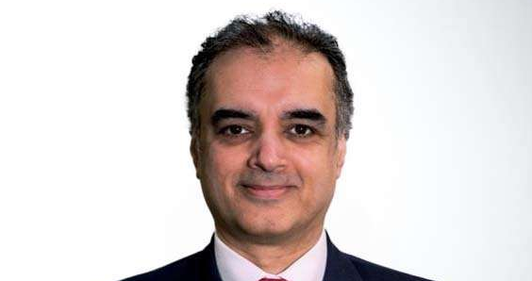
Also with us today
Anthony Marriott
Director of Treasury & Corporate Finance
Tariq Kazi
Group Treasurer
Agnieszka Thakur
Finance Director Financial Control and Operations
Richard Ellis
Director of Sustainability

Slide 5
New Peabody
One of the oldest not-for-profit housing associations in the UK.
We want to help people by providing great homes and services and making a positive impact in communities. We also create an inspiring, inclusive place to work.
Over 109,000 homes across London and the home counties
Around 220,000 residents
Over 23,000 care and support customers

Slide 6
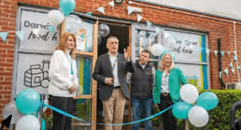
2023-24 update
£137 average weekly rent
£721m rent subsidy to market
£200m improving existing residents’ homes
Including £50m on Building Safety
And a further £171m on planned and routine maintenance
1,381 new homes completed 88% were for social, affordable or intermediate market rent or low-cost ownership
£10m community investment

Slide 7
Our operating environment
Significant economic challenges for the country
Government relations and regulatory changes
Continuing to manage the impact of rent cap
Improving services
Sustainability and net zero
New social homes
Our engagement and dialogue with the regulator, ombudsman and government is ongoing

Slide 8
Our financial
Phil Day
Chief Financial Officer

Slide 9
Half year results
Operating surplus
£130m before change in investment property valuation
£486m turnover
Credit rating A- Standard and Poor’s (negative), A3 Moody’s (stable)
G1, V2 governance rating
Capital investment
£97m in existing homes including £23m building safety
Planned and routine maintenance
Further £93m
Investment in new homes
£244m (225 new homes completed)
Sales
£150m exchanged or reserved in addition to £27m sales
Peabody investor update
November 2024

Slide 10
Sustainable
Anthony Marriott
Director of Treasury & Corporate Finance

Slide 11
Sustainable finance
Providing new affordable homes where we can
Improving the energy efficiency of homes
Reducing carbon emissions
Investing in communities
1

Slide 12
Our
Elly Hoult
Deputy Chief Executive & Chief Operating Officer

Slide 13
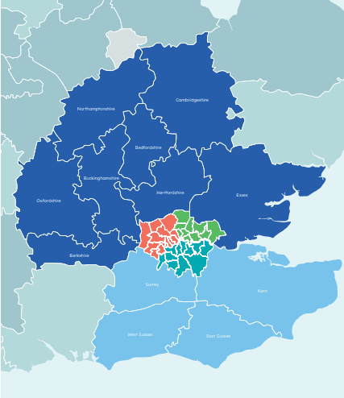
North Counties |  | North West London
20,877 |  | 26,465
South Counties |  | South London
13,912 |  | 23,653
North East London 23,916 |  | Total 108,823

Slide 14
Our transformation
Getting the basics right
Embedding Local Peabody
Building a resident first culture
Data and digital
We want to continuously improve resident satisfaction

Slide 15
Investing in
Peter Evans
Executive Director, Property Services & Assets

Slide 16
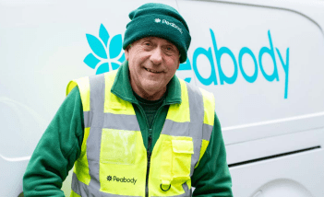
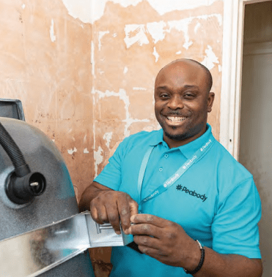
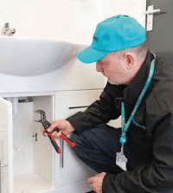
Investing in our existing homes
Getting repairs right
Satisfaction at 80%
£1m a day
£2bn over five years
Fire and building safety
1

Slide 17
Retrofitting and improving homes
Nearly 80% of residents’ homes rated EPC C (SAP rating of 73.94)
Almost all new homes meet at least EPC B
Retrofitting hundreds of homes as part of the GLA’s retrofit scheme and SHDF wave II
Carbon footprint increased 3.5%
EV charging points and vehicle fleet upgrade

Slide 18
Creating a sustainable
Richard Ellis
Director of Sustainability

Slide 19
Creating a sustainable Peabody
Making sustainability part of our everyday business
Turning plans into action with our Sustainability Action Plan
Still committed to being net zero in our day-to-day business by 2030 and across all rented homes by 2050
Awarded Certified Sustainable Housing label for the third time by RITTERWALD
Our fourth ESG Report

Slide 20
Green spaces and the future
Improving green spaces to make us more resilient to climate change
Committed to the government’s 10% biodiversity net gain for all new building projects
Whole-life carbon assessments
Energy management system to improve efficiency and reduce waste
Preparing for the future: Mapping our green and blue spaces. New Homes Sustainability Framework. Climate change designated as a key risk

Slide 21
Tariq Kazi
Group Treasurer

Slide 22
Thank you for

Slide 23
Disclaimer
The information contained in this investor presentation including the presentation slides and any related speeches made or to be made by the management of the Peabody Group (Peabody being Peabody Trust and its subsidiaries), any questions and any answers thereto or any related verbal or written communications in respect thereof (the Presentation) has been prepared to assist interested parties in making their own evaluation of Peabody. This presentation is believed to be in all material respects accurate, although it has not been independently verified and does not purport to be all-inclusive. This Presentation and its contents are strictly confidential, are intended for use by the recipient for information purposes only and may not be reproduced in any form or further distributed to any other person or published, in whole or in part, for any purpose. Failure to comply with this restriction may constitute a violation of applicable securities laws. By reading this Presentation, you agree to be bound by the following limitations.
Neither Peabody (nor any constituent part thereof) nor its or their representative directors, officers, managers, agents, employees or advisers or their respective affiliates, makes any representations or warranty (express or implied) or accepts any responsibility as to or in relation to the accuracy or completeness of the information in this Presentation (and no one is authorised to do so on behalf of any of them) and (save in the case of fraud) any liability in respect of such information or any inaccuracy therein or omission therefrom is hereby expressly disclaimed, in particular, if for reasons of commercial confidentiality information on certain matters that might be of relevance to a prospective purchaser has not been included in this Presentation.
No representation or warranty is given as to the achievement or reasonableness of any projections, estimates, prospects or returns contained in this Presentation or any other information. Neither Peabody nor any other person connected to Peabody shall be liable (whether in negligence or otherwise) for any direct, indirect or consequential loss or damage suffered by any person as a result of relying on any statement in or omission from this Presentation or any other information and any such liability is expressly disclaimed. This Presentation may include certain statements, estimates and projections prepared and provided by Peabody’s management with respect to the anticipated future performance
of Peabody. Such statements, estimates and projections reflect various assumptions by Peabody’s management concerning anticipated results and have been included solely for illustrative purposes. No representations are made as to the accuracy of such statements, estimates or projections or with respect to any other materials herein. Actual results may vary from the projected results contained herein.
Any Notes issued by Peabody Group have not been and will not be registered under the U.S. Securities Act of 1933, as amended (the Securities Act), or the laws of any state or other jurisdiction of the United States, and may not be offered or sold within the United States, or for the account or benefit of, U.S. Persons (as such terms are defined in Regulation S under the Securities Act), absent registration or an exemption from, or in a transaction not subject to, the registration requirements of the Securities Act and applicable state laws. This Presentation is made to and is directed only at persons who are (a) “investment professionals” as defined under Article 19 of the Financial Services and Markets Act 2000 (Financial Promotion) Order 2005, as amended (the Order) or (b) high net worth entities falling within article 49(2)(a) to (d) of the Order (all such persons together being referred to as relevant persons). Any person who is not a relevant person should not act or rely on this Presentation or any of its contents. Any investment or investment activity to which this Presentation relates is available only to and will only be engaged in with such relevant persons.

